Slide 1
Human Trafficking in Texas
Information from the Texas Department of Health and Human Services, Texas Governor, Texas Attorney General and the National Human Trafficking Hotline
This presentation does not count for continuing education credit for any health care practitioners in the audience

Slide 2
TSO Legislative Committee 2021-2023
Sharon Gullett-Area 1, Theta Nu
Lindsey Pollock,-Area 3, Delta Upsilon
Maria V Gonzales-Area 5, Alpha Mu
Elizabeth Brown-Theta Beta, Area 6
Diane Hess-Area 7, Nu Alpha
Virginia Riddle-Area 8, Tau
Robin Lock-Area 12, Kappa Iota
Janet McMurray-Area 11, Gamma Epsilon
Libby Horton-Area 1, Mu Tau

Slide 4
Texas Human Trafficking Resource Center
The Texas Human Trafficking Resource Center connects Health and Human Services staff, health care providers, stakeholders and those who have experienced human trafficking to resources needed to locate services, help prevent trafficking, and recognize and respond to potential trafficking situations.
Call 9-1-1 for the local police department
Contact the National Human Trafficking Hotline:
Call: 1-888-373-7888 (TTY: 711)
Text: 233733
Chat Online: Human Trafficking Hotline Web Chat

Slide 5
What Is Human Trafficking?
Human trafficking is a crime that involves exploiting a person for labor, services or commercial sex. The United States Department of Justice classifies human trafficking into two major categories:
Sex trafficking is the recruitment, harboring, transportation, provision, obtaining, patronizing or soliciting of a person for the purposes of a commercial sex act, in which the commercial sex act is induced by force, fraud, or coercion, or in which the person induced to perform such an act is 17 or younger.
Labor trafficking involves the recruitment, harboring, transportation, provision or obtainment of a person through the use of force, fraud or coercion for the purpose of involuntary servitude, peonage, debt bondage or slavery.

Slide 6
Resources from Ken Paxton, Attorney General of Texas
Be-The-One-Poster.pdf (texasattorneygeneral.gov)
Office of the Attorney General Initiatives | Office of the Attorney General (texasattorneygeneral.gov) Be The One video

Slide 7
How Do I Identify Human Trafficking in My Practice?
Many trafficked persons interact with the health care system while being trafficked. Health care providers often do not recognize the signs of trafficking or are unsure of how to help. Trafficked persons often do not disclose their situation.

Slide 8
The following lists indicators, or red flags, to look for when treating your patients.
Physical Health
Frequent treatment of sexually transmitted infections or injuries
Multiple unwanted pregnancies
Fractures or burns
Bruising
Gastrointestinal problems
Skin or respiratory problems caused by exposure to agricultural or other chemicals
Communicable and non-communicable diseases
Oral health issues, including broken teeth
Chronic pain
Signs of concussions, traumatic brain injuries or unexplained memory loss
Malnutrition

Slide 9
Behavioral Health
Unwilling to answer questions about their health
Unable to concentrate or provide basic information including age, address or time
Gives confusing or contradicting information
Abuses substances
Has depression or anxiety
Appears nervous or avoids eye contact
Has post-traumatic stress disorder

Slide 10
Other Indicators of Trafficking
Another person appears to be in control and does not let them answer questions
Reports a high number of sexual encounters
Does not have possession of their own identification documents
Lives in an overcrowded area or at their workplace
Has tattoos or branding of ownership
Wears inappropriate clothing for the weather or venue

Slide 11
Health Care Practitioner Human Trafficking Training | Texas Health and Human Services
the Texas Department of Health and Human Services provides training for Health Care Practitioners.

Slide 12
Screening Tools for Health Care Practitioners
Commercial Sexual Exploitation-Identification Tool (CSE-IT)
Short Child Sex Trafficking Screen for the Health care Setting
Adult Human Trafficking Screening Tool and Guide
Trafficking Victim Identification Tool and Manual
All tools available on: Texas Human Trafficking Resource Center | Texas Health and Human Services

Slide 13
Provider Guidebook: Services for Victims of Human Trafficking in Texas

Slide 14
Office of the Governor Child Sex Trafficking Team (CSTT)
CSTT coordinates a holistic response to child sex trafficking in Texas. CSTT’s mission is to build sustainable capacity, enhance expertise, promote policies and leverage collaborations to:
Protect children and youth from sexual exploitation.
Help the public recognize sexual exploitation.
Help victims recover.
Support healing.
Bring justice to those that exploit children.
Learn more on the Office of the Governor Child Sex Trafficking Team website.

Slide 15
TEA Mandates—December 2020
All educators are required to report suspicions of child abuse and neglect, including trafficking of a child, within 48 hours (Texas Family Code, 261.101)
To Report Abuse:
If it is an emergency—Call 911 or law enforcement immediately
If it is a heightened concern—Call Texas Abuse Hotline at 1-800-858-5400
If it is a hunch or worry—Report online at Texas Abuse Hotline
Other reporting options are—National Human Trafficking Hotline at 1-888-373-7888
Cyber Tipline at www.cybertipline.com or 1-800-843-5678

Slide 16
TEA Mandates—December 2020
Information handbooks must include the following for students and parents:
Sexual abuse, trafficking and other forms of maltreatment of children,
Including prevention techniques and knowledge of likely warning signs indicating that a child may be a victim.
How to obtain assistance and intervention
Available counseling

Slide 17
TEA Mandates—December 2020
Prevention Education
Local districts must include child abuse anti-victimization programs in elementary and secondary schools consisting of age-appropriate, research-based prevention designed to promote self-protection and prevent sexual abuse and trafficking.

Slide 18
TEA Mandates—December 2020
Required Trainings
Superintendent—2/5 hours of training every 5 years
Trainings to include
Warning signs
Internal procedures
Techniques to reduce a child’s risk
Information of community organizations with programs
Maintaining records

Slide 19
TEA Mandates—December 2020
Required Trainings
Educators
All new employees during orientation or those not previously trained
Recommended annually

Slide 20
Key tips for educators
Remain calm
Believe the child
Allow the child to talk
Show interest and concern
Reassure and support the child’s feelings
Take action! It could save a child’s life

Slide 21
Don’t
Panic or overreact
Press the child to talk
Promise anything you can’t control
Confront the offender
Blame or minimize the child’s feelings
Overwhelm the child with questions or ask the child to repeat their outcry to additional school personnel
Report to CPS solely based on the parent’s refusal to seek psychiatric or psychological treatment of the child

Slide 22
Human trafficking of school-aged children
Texas Education Agency addresses human trafficking on the TEA website and with requirements to be met by the end of the 2022-2023 school year.
Each School shall post warning signs at the following locations:
Parallel to and along the exterior boundaries of the school’s premises;
At each roadway or way of access to the premises;
For premises not fenced, at least every five hundred feel along the exterior boundaries of the premises;
At each entrance to the premises and building, and’
At conspicuous places reasonably likely to be viewed by all persons entering the premises. (TAC 61l1053(b)

Slide 23
TEA Child abuse and awareness webinars
Webinars were held throughout the 2022-2023 school year on the following topics.
Reporting Child Abuse including Human Trafficking
Trends in Trafficking
Prevention: Exploring the Health TEKS and other Resources
Panel Discussion Child Abuse Presentation Month

Slide 24
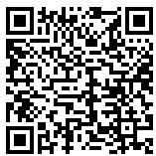
Rise to the challenge training
Human Trafficking of School-aged Children | Texas Education Agency

Slide 26
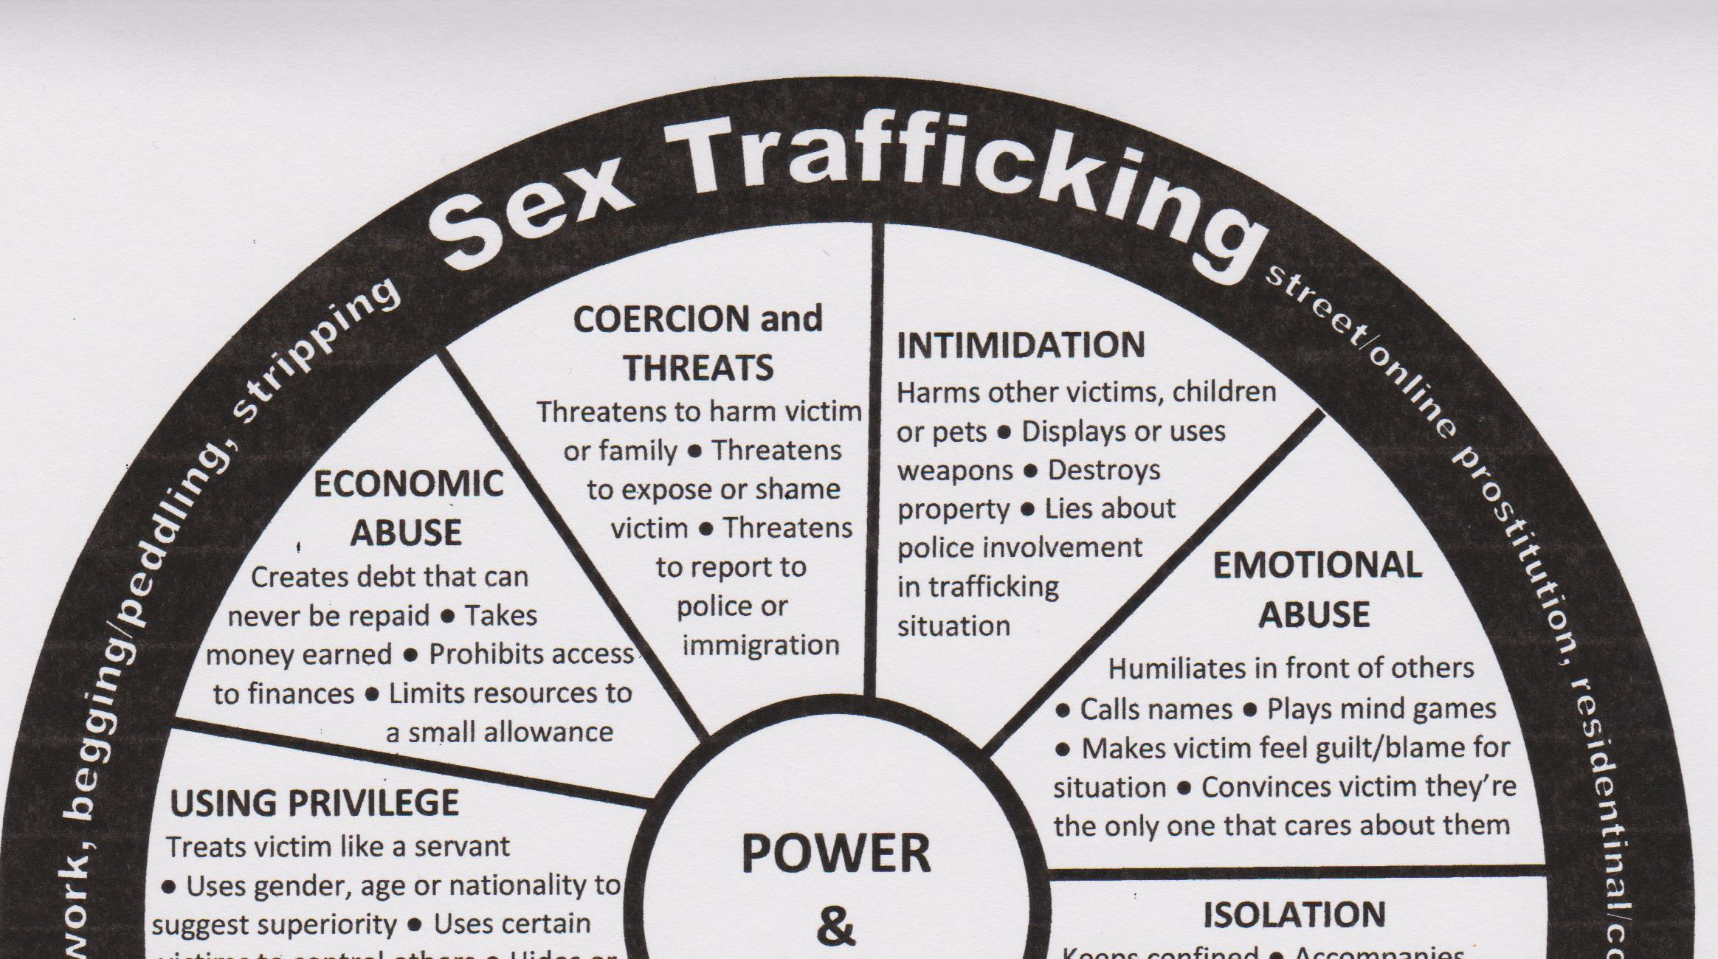

Slide 27
Preventing Human Trafficking
Raise Awareness
Know. Watch. Report.

Slide 28
Texas Human Trafficking Prevention Coordinating Council
Created by the Texas Legislature in 2019, this Council works towards effectively and efficiently eradicating human trafficking through the coordination and collaboration of programs, services and state resources.
Learn more on the Texas Human Trafficking Prevention Coordinating Council website.

Slide 29
Report Human Trafficking
National Human Trafficking Hotline accepts anonymous tips:
Call: 1-888-373-7888 (TTY: 711)
Text: 233733
National Human Trafficking Hotline

Slide 30
Citations
Texas Department of Health and Human Services
Texas Attorney General, Ken Paxton
Texas Council on Human Trafficking
Office of the Governor Child Sex Trafficking Team
Texas Human Trafficking Prevention Coordinating Council
National Human Trafficking Hotline
Texas Education Agency
dhs.gov/bluecampaign

Slide 31
Resources

